Slide 1
Analyze the non-autonomous systems by adapting (extending) the tools we developed for autonomous systems.

Slide 2
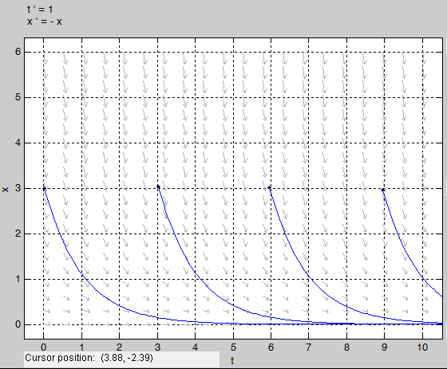
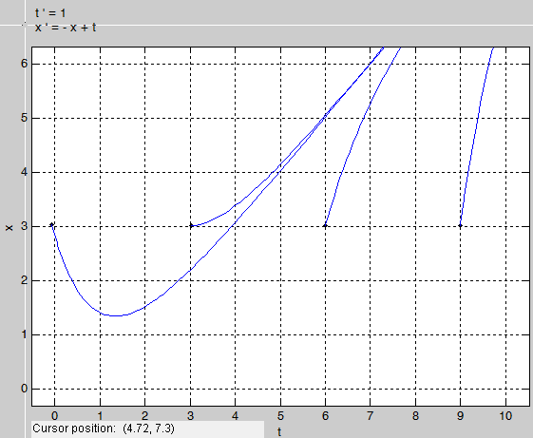
Response not affected by t₀
Autonomous vs. Nonautonomous
x(t) versus time (t)
t₀=0
t₀=3
t₀=6
t₀=9
x(t₀)=3
x(t)
Response depends on t₀
x(t) versus time (t)
time (t)
Autonomous
t₀=3
x(t₀)=3
t₀=0
x(t)
t₀=6
t₀=9
Nonautonomous
time (t)

Slide 3
Motivation: The Tracking Problem
Up until now we have only talked about regulation (stabilizing the system to an equilibrium point). That problem yielded an autonomous system even with state feedback.
Based on what we already know a solution may look like this
Looking at the closed-loop system we see that it is non-autonomous.
Do the tools for autonomous systems support this result???

Slide 4
Difference from autonomous: added this constraint on the initial condition t₀

Slide 5
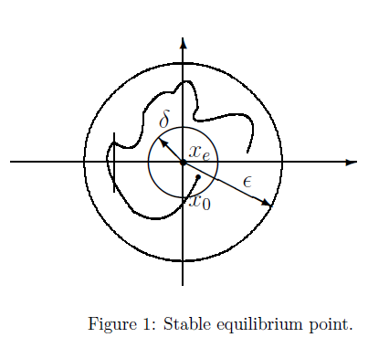
Difference from autonomous: added this constraint on the initial condition t₀
Evolution of the state from same initial state but different starting times
t₀₁
(Modified from Chapter 3)

Slide 6
Difference from autonomous: added this constraint on the initial condition t₀

Slide 7
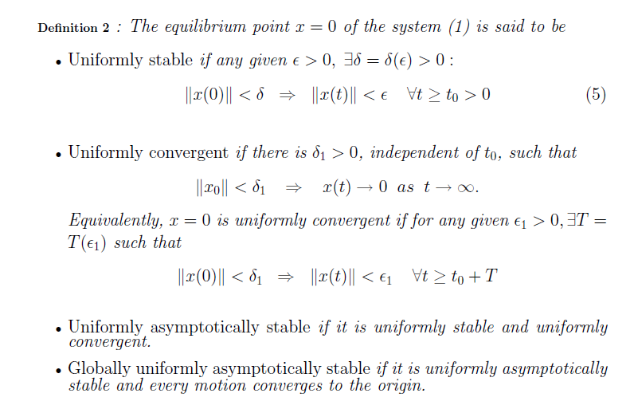
Bound on initial condition is independent of the initial time.
Independent of t₀
Independent of t₀
Independent of t₀

Slide 8
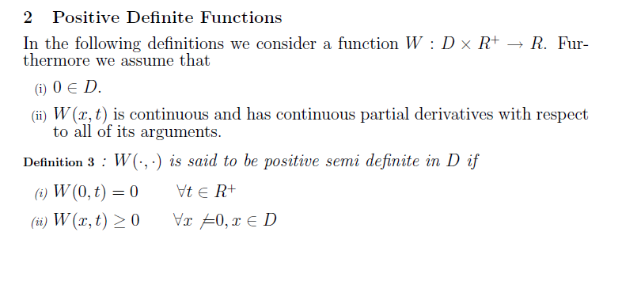

Slide 9
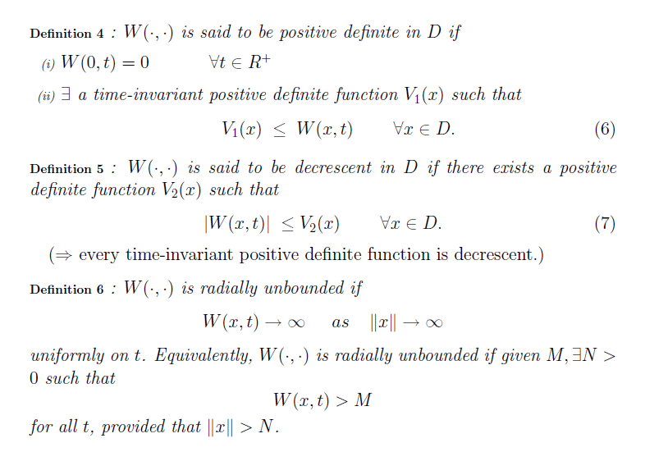

Slide 10
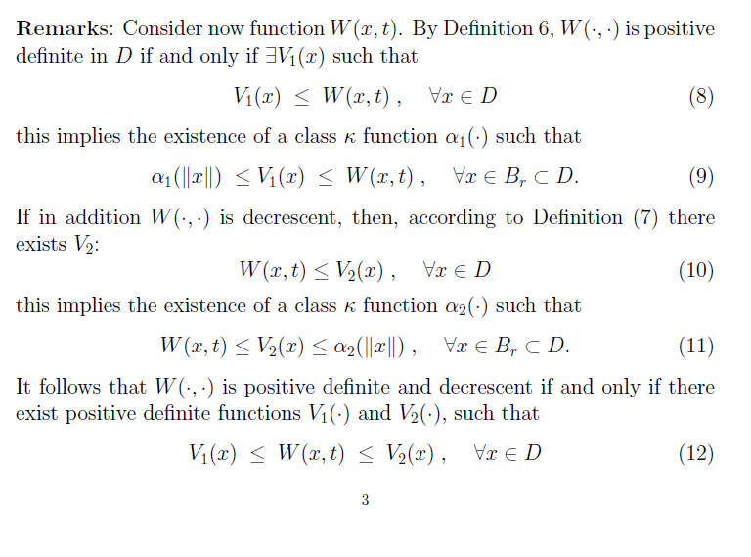

Slide 12
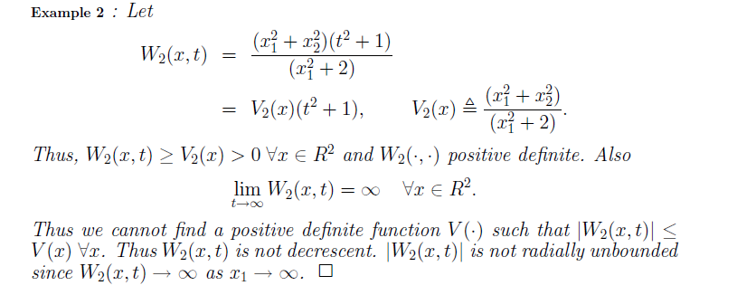

Slide 13
(cont)
1

Slide 16
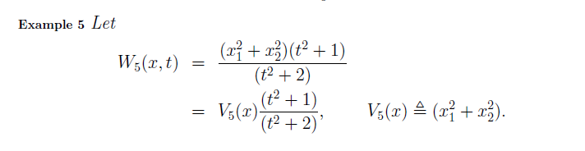

Slide 19
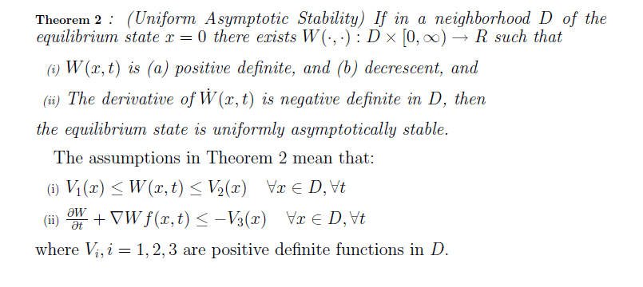

Slide 24
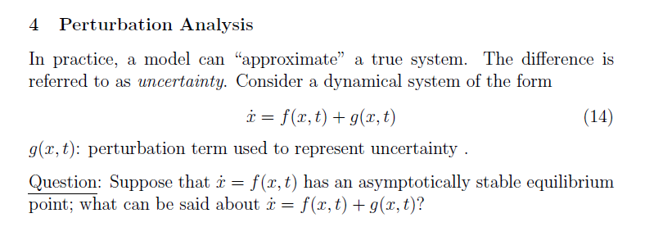
?

Slide 25
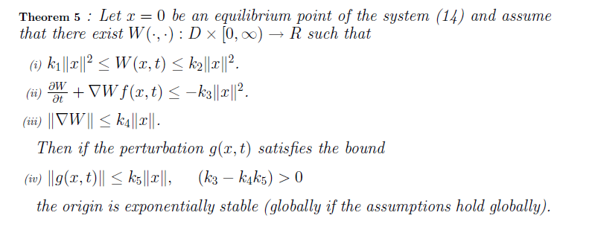

Slide 26
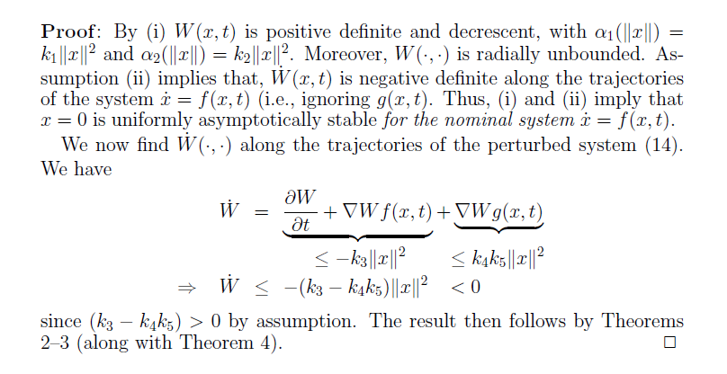

Slide 27
Example 1 of Perturbation Analysis

Slide 28
Example 1 of Perturbation Analysis (cont)

Slide 29
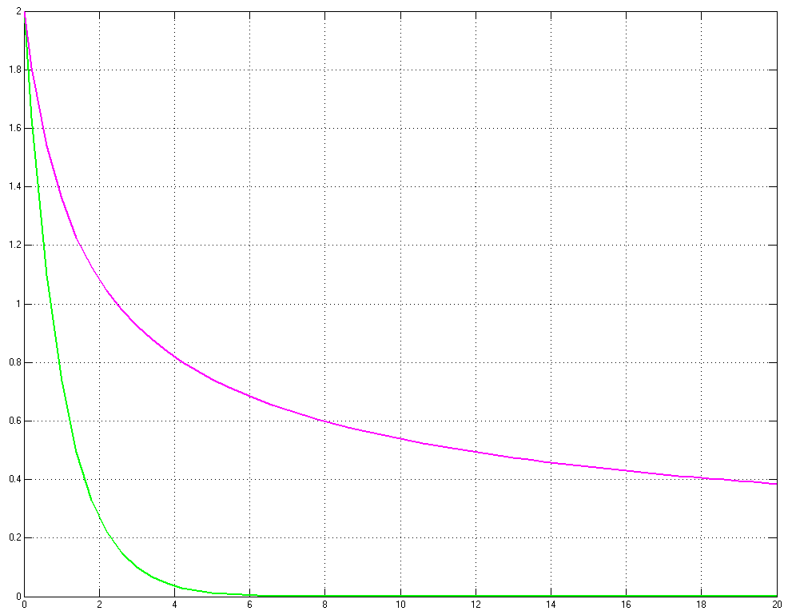
Example 1 of Perturbation Analysis (cont)
Perturbed system
Unperturbed system
Time

Slide 30
Example 2 of Perturbation Analysis
+0
g(x,t)

Slide 31
Example 2 of Perturbation Analysis (cont)

Slide 32
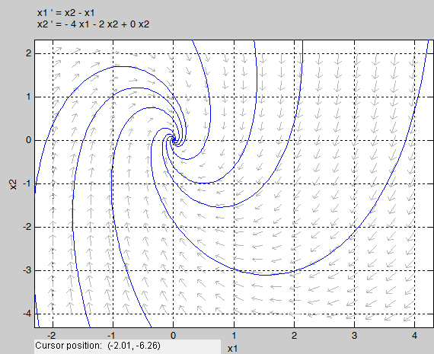
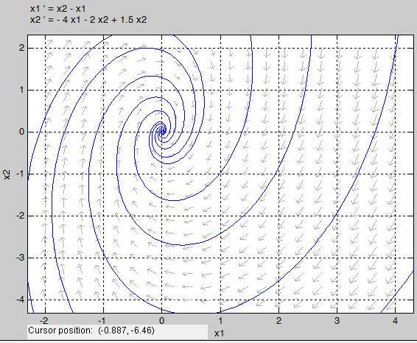
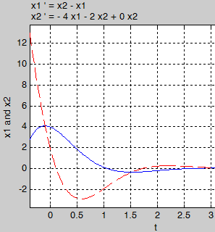
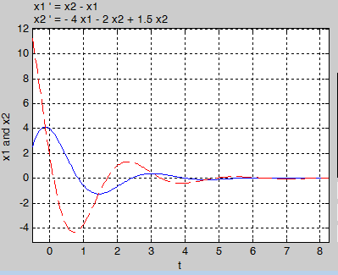
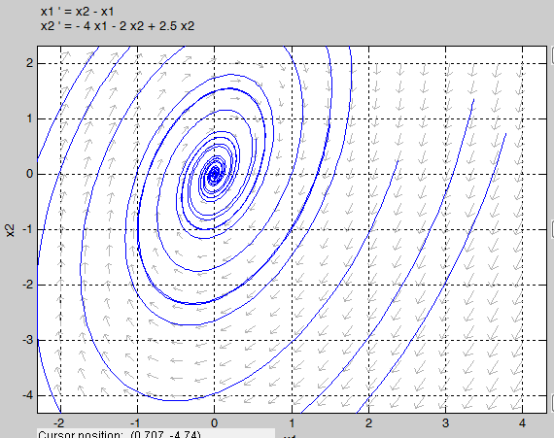
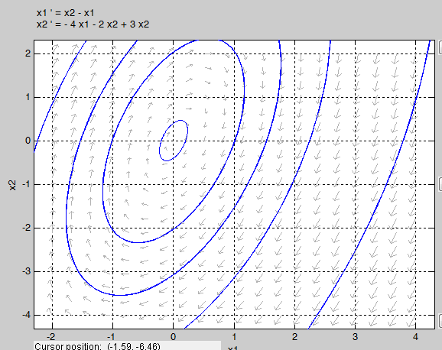
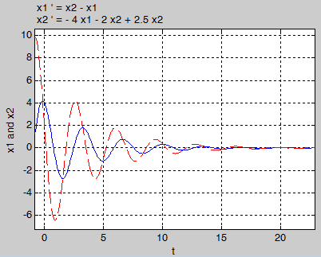
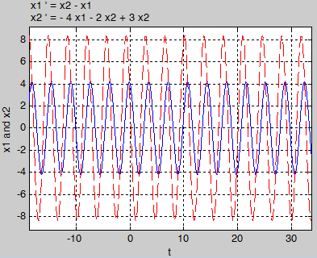
Example 2 of Perturbation Analysis (cont)

Slide 33
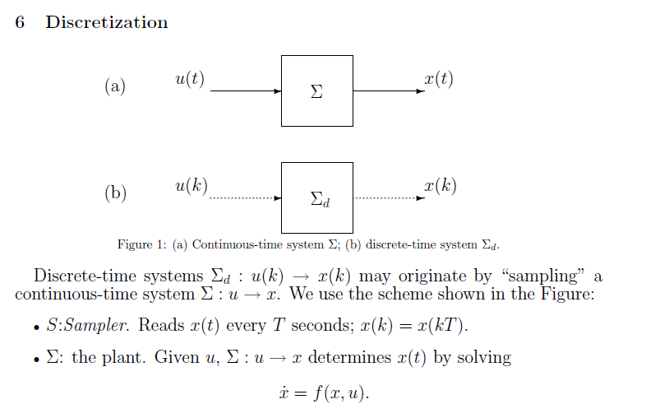

Slide 34
Cont.
Cont.
Discrete
Discrete

Slide 35
x(t)
t
Example: Digital Motor Controller
D/A +
Amplifier
voltage
position
Encoder
(A/D)
Normally we make the assumption that if the sample rate is high then it acts like a continuous system.
Motor
Micro Controller
(control algorithm)

Slide 36
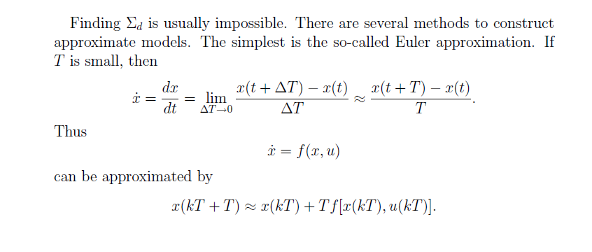
Approximation of slope at t=kT
System at kT

Slide 37
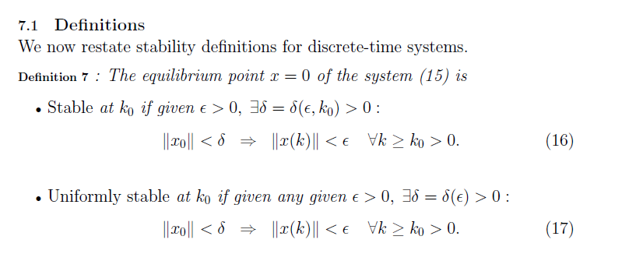

Slide 38
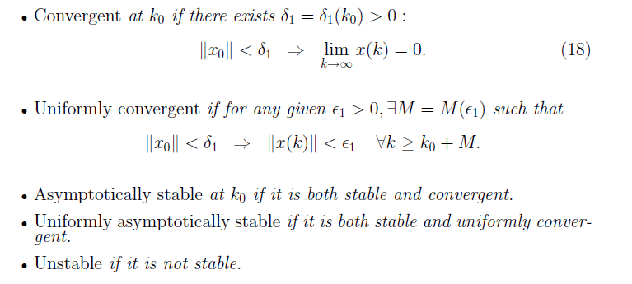

Slide 39
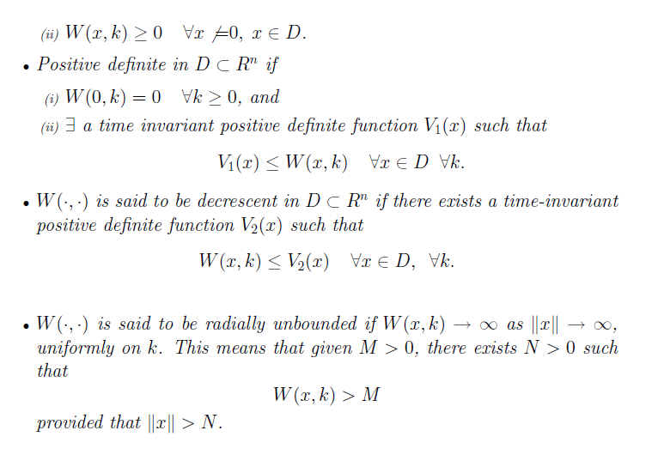

Slide 40
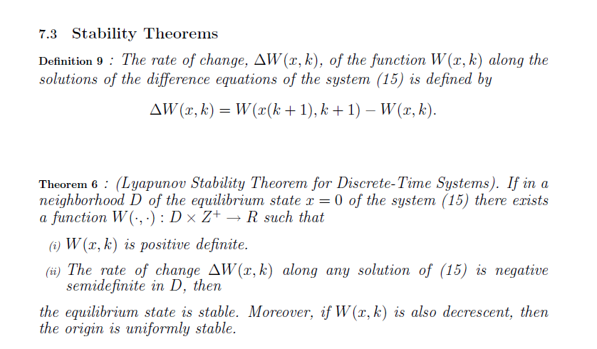

Slide 43
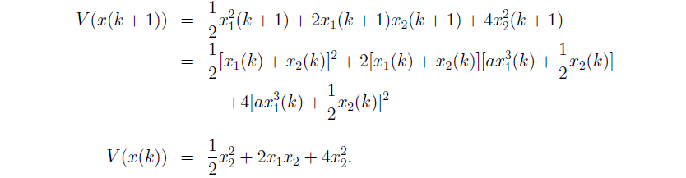
Example 7 (cont)
Original System
1

Slide 44
Example 7 (cont)

Slide 45
Extra – Barbalat’s Lemma (Slotine page 124-128)

Slide 47
Conclusion
Have extended idea of Lyapunov function analysis to nonautonomous systems.
Perturbation analysis examined the effect of disturbances (of a specific form).
Have extended idea of Lyapunov function analysis to discrete time systems.
Extended the Lyapunov analysis using Barbalat’s Lemma to make a statements about the derivative of the Lyapunov function.

Slide 48
Homework 4.1
Marquez Problems 4.4, 4.5

Slide 49
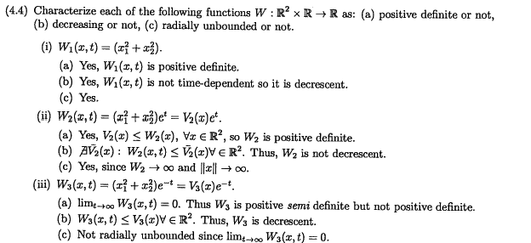
Homework 4.1 (sol)
Doesn’t exist

Slide 50
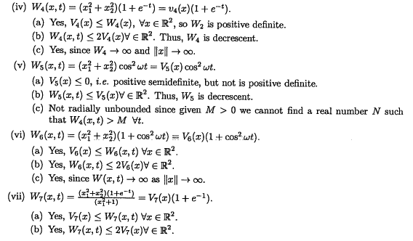
Homework 4.1 (sol)

Slide 51
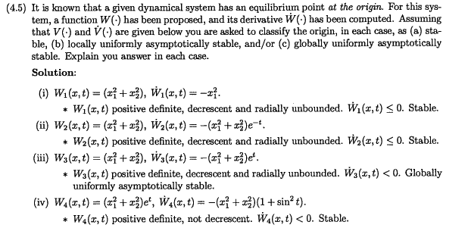
Homework 4.1 (sol)

Slide 52
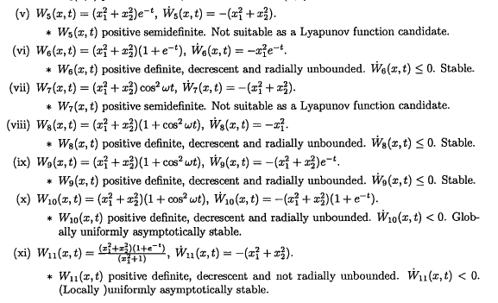
Homework 4.1 (sol)

Slide 53
Homework 4.2

Slide 54
Homework 4.2 (sol)

Slide 55
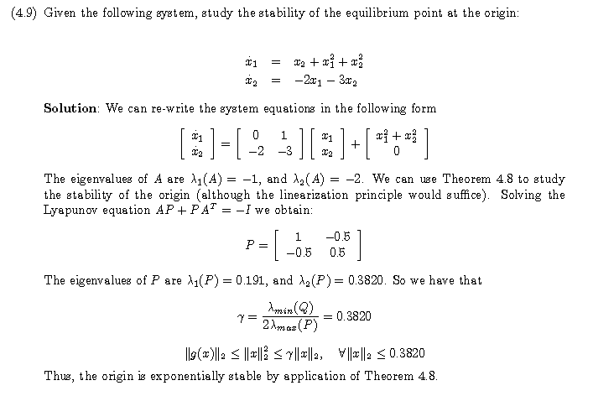
Homework 4.2 (sol)

